Slide 1



AtliQ Mart
Supply Chain Analysis
Provide Insights to Solve a Supply Chain Issue in the FMCG domain
Presented by
Sidhant Bisht

Slide 2

Table of Content
Problem Statement
Objective
Business-related terms
Data Information
Data Model
Dashboard
Insights
Recommendations

Slide 3
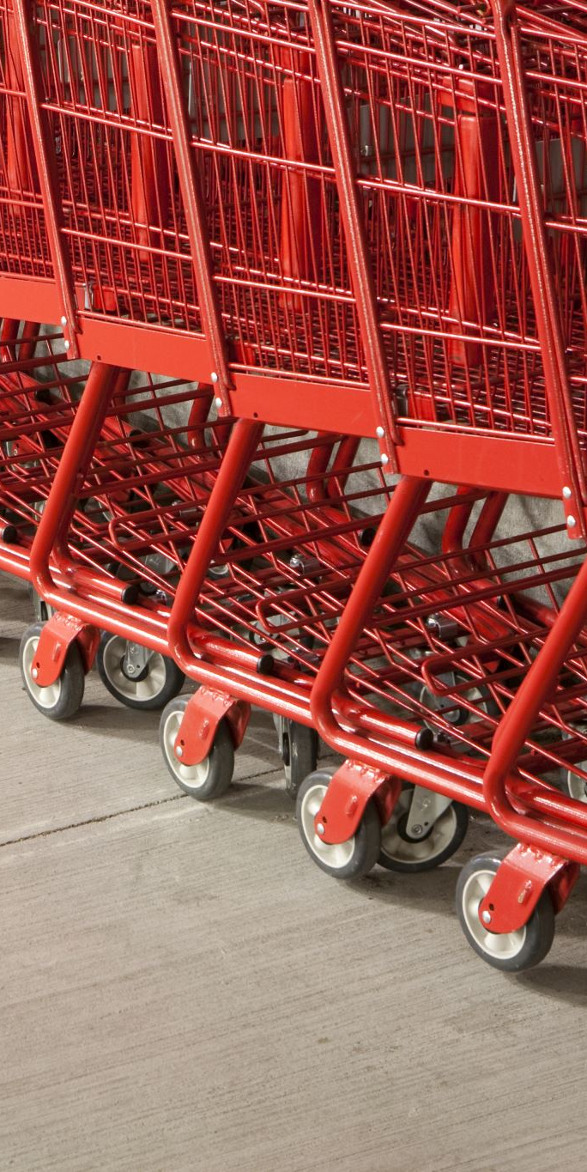
Problem Statement
AtliQ Mart is a growing FMCG manufacturer headquartered in Gujarat, India. It is currently operational in three cities Surat, Ahmedabad and Vadodara. They want to expand to other metros/Tier 1 cities in the next 2 years.
AtliQ Mart is currently facing a problem where a few key customers did not extend their annual contracts due to service issues. It is speculated that some of the essential products were either not delivered on time or not delivered in full over a continued period, which could have resulted in bad customer service. Management wants to fix this issue before expanding to other cities and requested their supply chain analytics team to track the ’On time’ and ‘In Full’ delivery service level for all the customers daily basis so that they can respond swiftly to these issues.

Slide 4

Objective
The objective of this project is to measure the service levels of Atliq Mart's supply chain operations using a standardized approach.
Specifically, we focused on three key metrics: "On-Time Delivery (%)," "In-Full Delivery (%)," and "On-Time In Full (%)" for customer orders on a daily basis. These metrics were compared against the target service levels established for each customer.

Slide 5

Business-related terms
Order Lines
OT % - On time delivery percentage
IF % - In Full delivery percentage
OTIF % - On time and In Full delivery percentage
LIFR - Line Fill Rate
VOFR - Volume Fill Rate

Slide 6

Data Information
we have 6 CSV files:
1. dim_customers.csv
2. dim_products.csv
3. dim_date
4. dim_targets_orders
5. fact_order_lines.csv
6. fact_orders_aggregate.csv
To download the files please click the link here (Codebasics resume project challenge #2) : https://codebasics.io/challenge/codebasics-resume-project-challenge

Slide 7

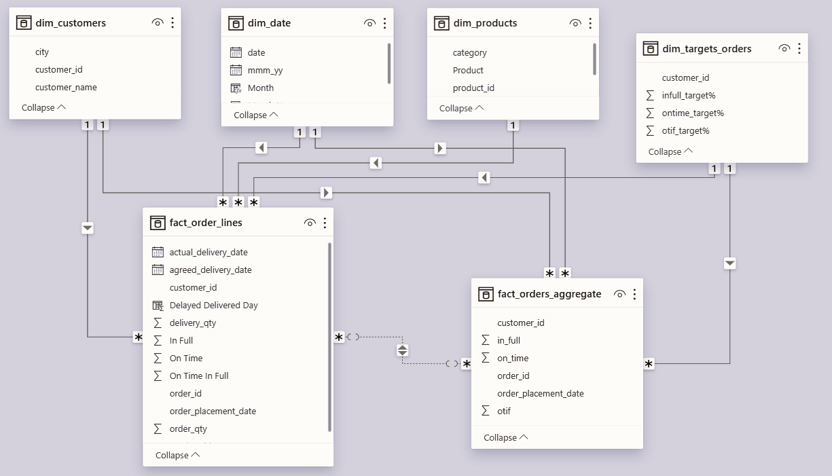
Data Model

Slide 8



DashBoard
Live Dashboard Link: https://www.novypro.com/project/atliq-mart-supply-chain-analysis-6

Slide 9
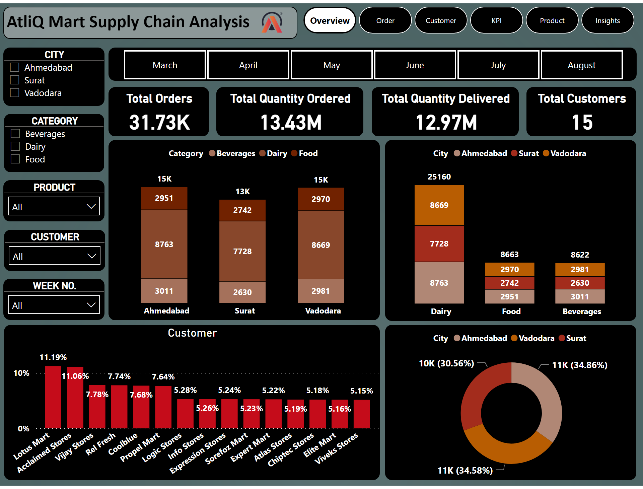
Overview
Notes:
image
No alt text provided
textbox
No alt text provided
CITY
No alt text provided
CATEGORY
No alt text provided
CUSTOMER
No alt text provided
PRODUCT
No alt text provided
Month
No alt text provided
donutChart
No alt text provided
Customer
No alt text provided
columnChart
No alt text provided
columnChart
No alt text provided
WEEK NO.
No alt text provided
Total Orders
No alt text provided
Total Quantity Ordered
No alt text provided
Total Quantity Delivered
No alt text provided
Total Customers
No alt text provided
pageNavigator
No alt text provided

Slide 10
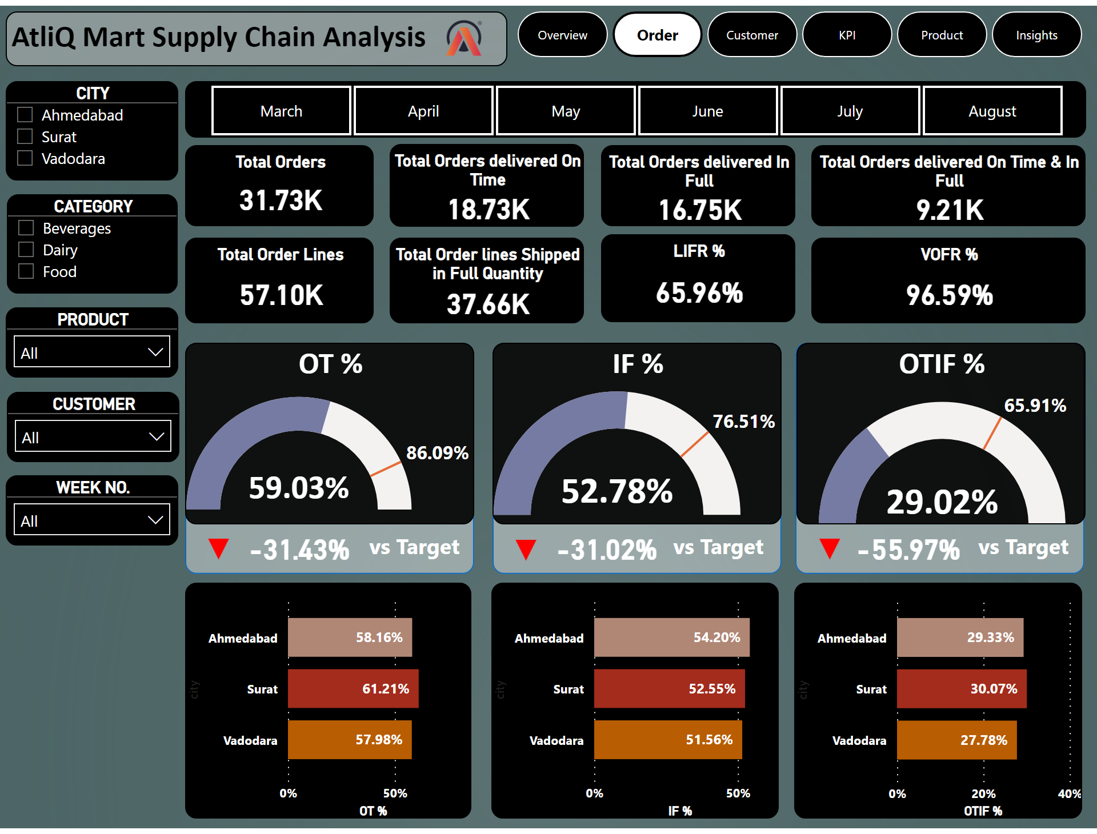
Order
Notes:
image
No alt text provided
textbox
No alt text provided
OT %
No alt text provided
textbox
No alt text provided
card
No alt text provided
card
No alt text provided
shape
No alt text provided
card
No alt text provided
card
No alt text provided
textbox
No alt text provided
IF %
No alt text provided
shape
No alt text provided
card
No alt text provided
OTIF %
No alt text provided
card
No alt text provided
textbox
No alt text provided
shape
No alt text provided
barChart
No alt text provided
barChart
No alt text provided
barChart
No alt text provided
Month
No alt text provided
CITY
No alt text provided
CATEGORY
No alt text provided
PRODUCT
No alt text provided
CUSTOMER
No alt text provided
WEEK NO.
No alt text provided
Total Orders
No alt text provided
Total Orders delivered On Time
No alt text provided
Total Orders delivered In Full
No alt text provided
Total Orders delivered On Time & In Full
No alt text provided
LIFR %
No alt text provided
VOFR %
No alt text provided
Total Order lines Shipped in Full Quantity
No alt text provided
Total Order Lines
No alt text provided
pageNavigator
No alt text provided

Slide 11
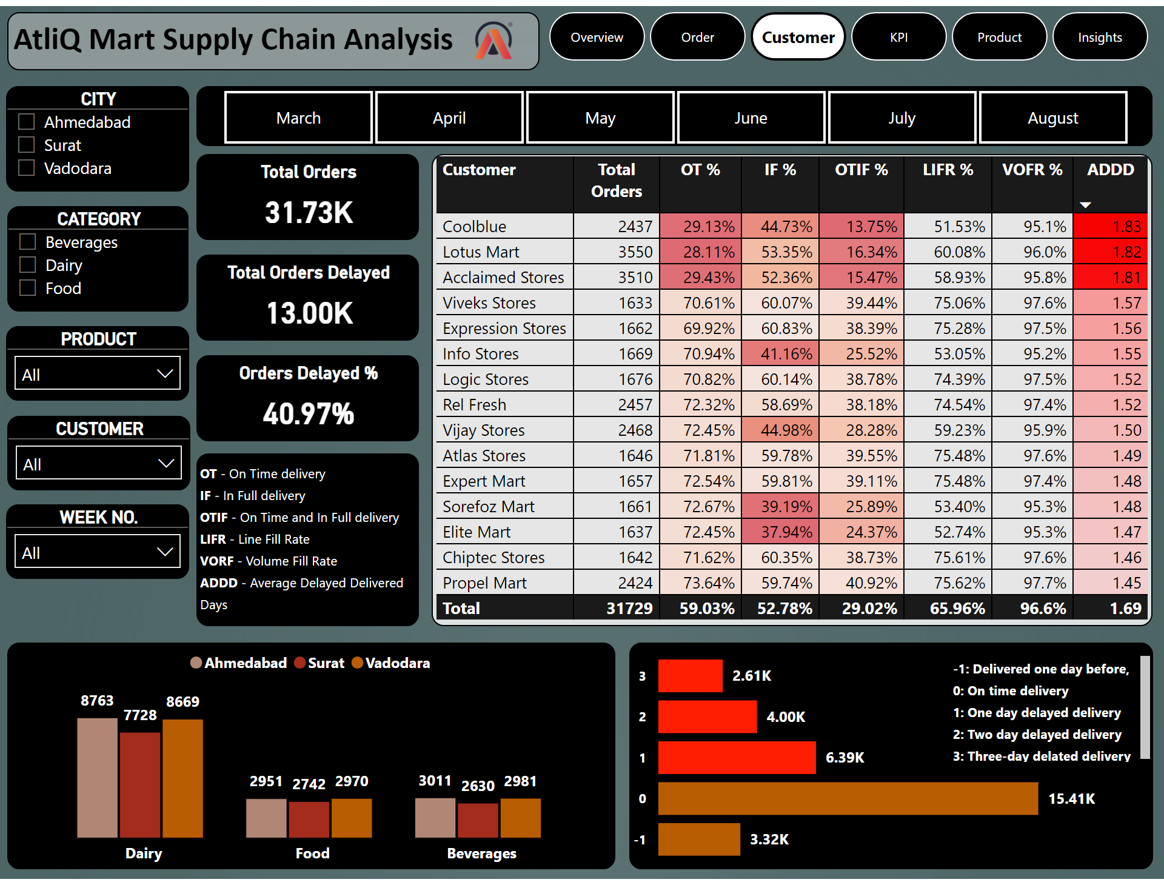
Customer
Notes:
CITY
No alt text provided
Month
No alt text provided
CATEGORY
No alt text provided
PRODUCT
No alt text provided
CUSTOMER
No alt text provided
WEEK NO.
No alt text provided
image
No alt text provided
textbox
No alt text provided
tableEx
No alt text provided
Total Orders
No alt text provided
textbox
No alt text provided
barChart
No alt text provided
Total Orders Delayed
No alt text provided
Orders Delayed %
No alt text provided
textbox
No alt text provided
clusteredColumnChart
No alt text provided
pageNavigator
No alt text provided

Slide 12
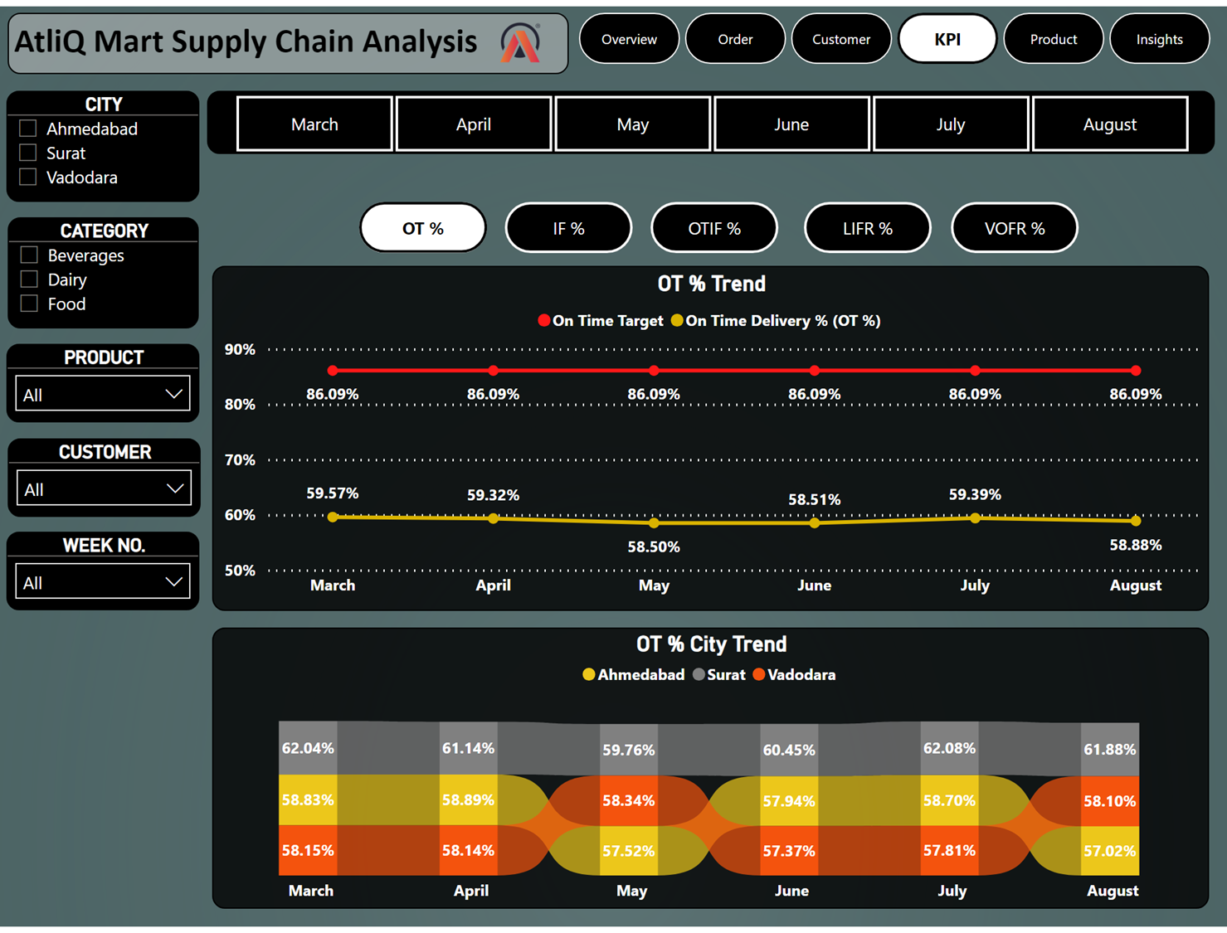

Slide 13
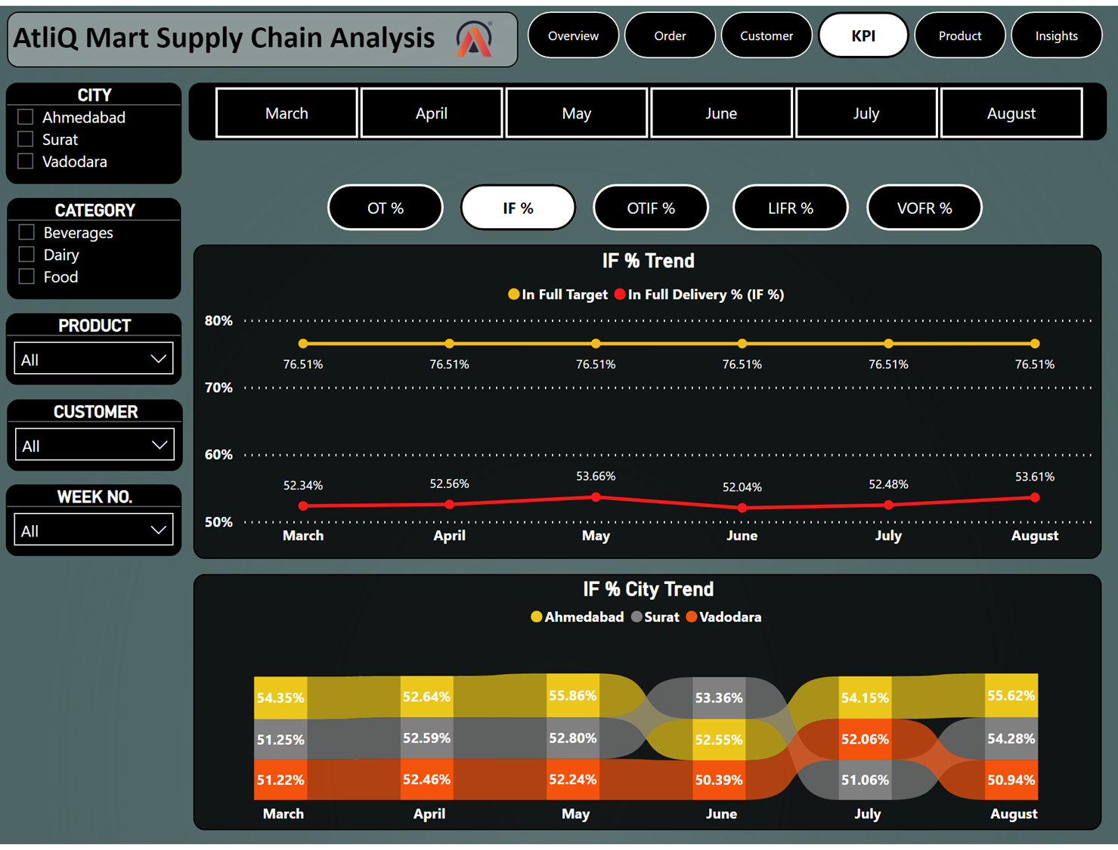

Slide 14
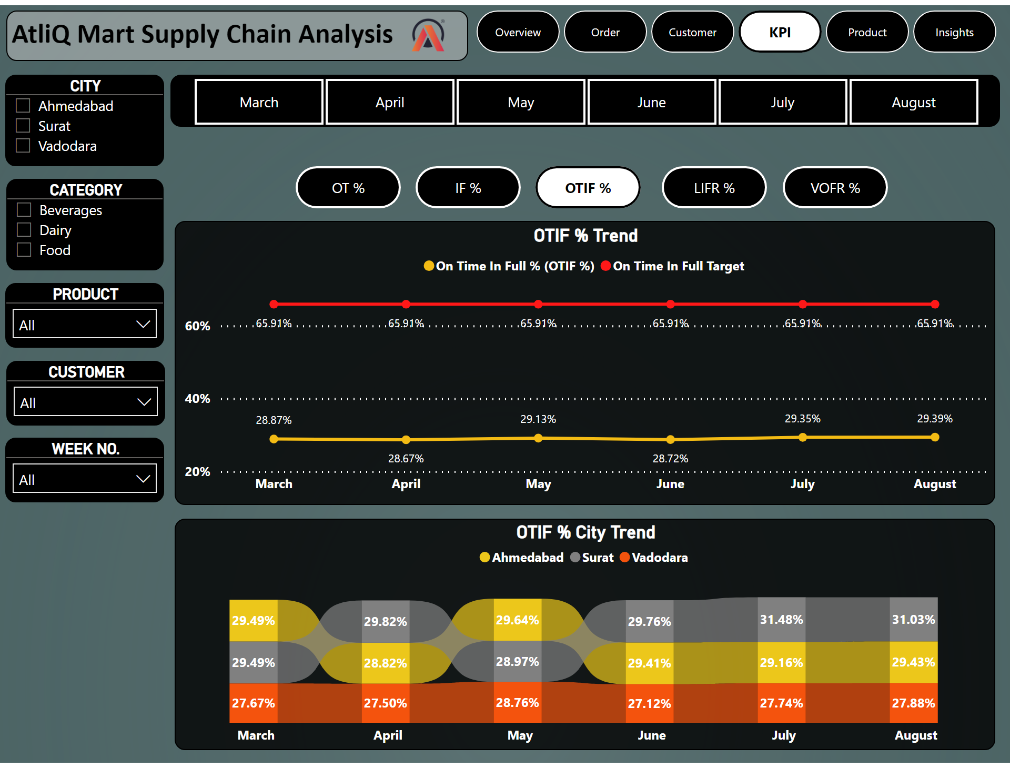
KPI
Notes:
CITY
No alt text provided
Month
No alt text provided
CATEGORY
No alt text provided
PRODUCT
No alt text provided
CUSTOMER
No alt text provided
WEEK NO.
No alt text provided
image
No alt text provided
textbox
No alt text provided
lineChart
No alt text provided
lineChart
No alt text provided
lineChart
No alt text provided
OTIF % Trend
No alt text provided
lineChart
No alt text provided
OT BLACK
No alt text provided
IF BLACK
No alt text provided
OTIF BLACK
No alt text provided
LIFR BLACK
No alt text provided
VOFR BALCK
No alt text provided
actionButton
No alt text provided
actionButton
No alt text provided
OTIF WHITE
No alt text provided
actionButton
No alt text provided
actionButton
No alt text provided
ribbonChart
No alt text provided
ribbonChart
No alt text provided
OTIF % City Trend
No alt text provided
ribbonChart
No alt text provided
ribbonChart
No alt text provided
pageNavigator
No alt text provided

Slide 15
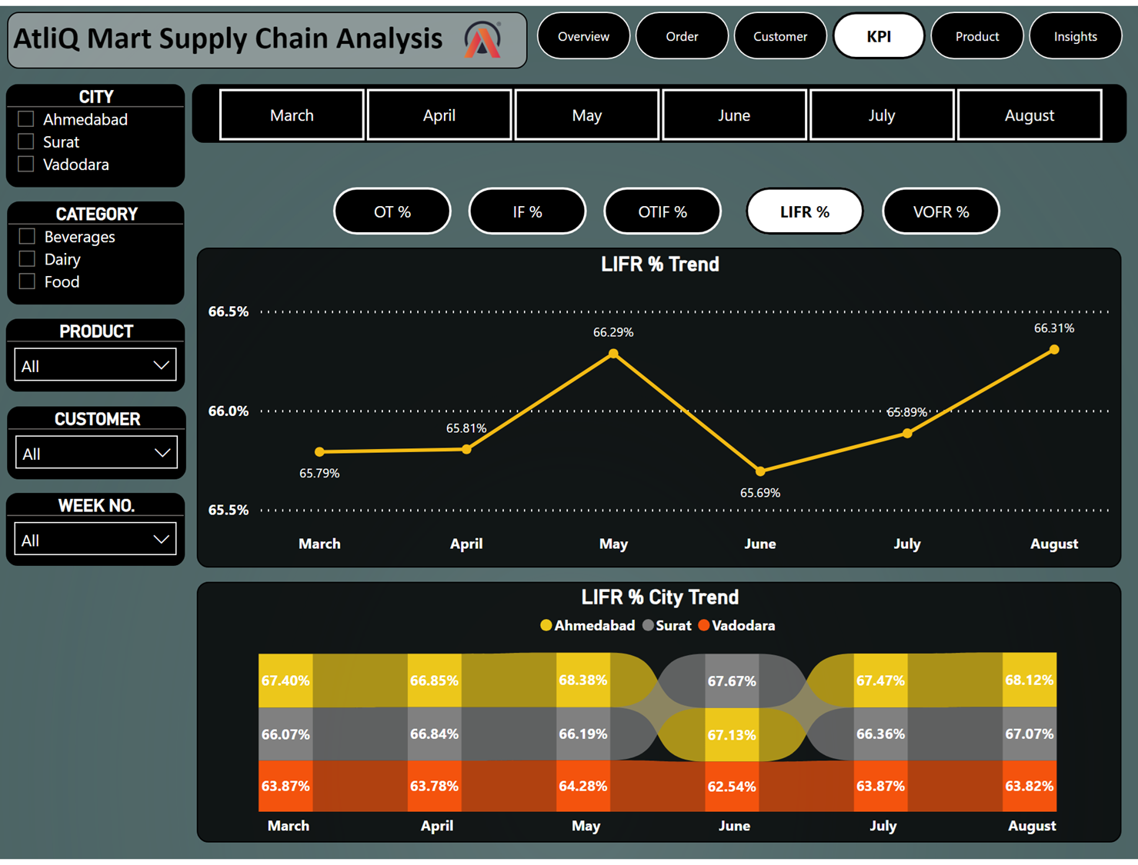

Slide 16
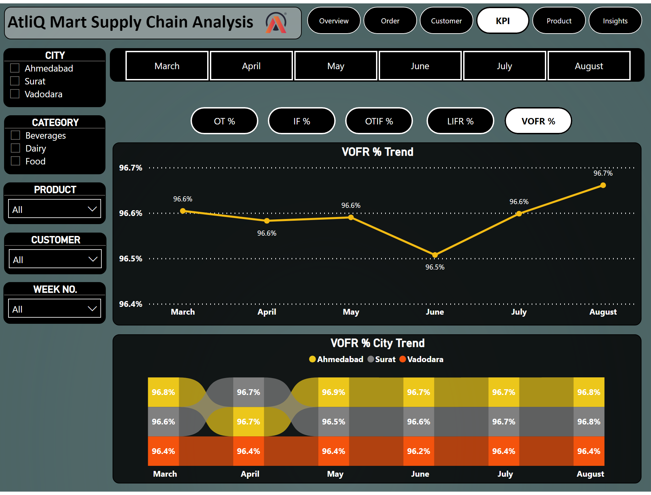

Slide 17
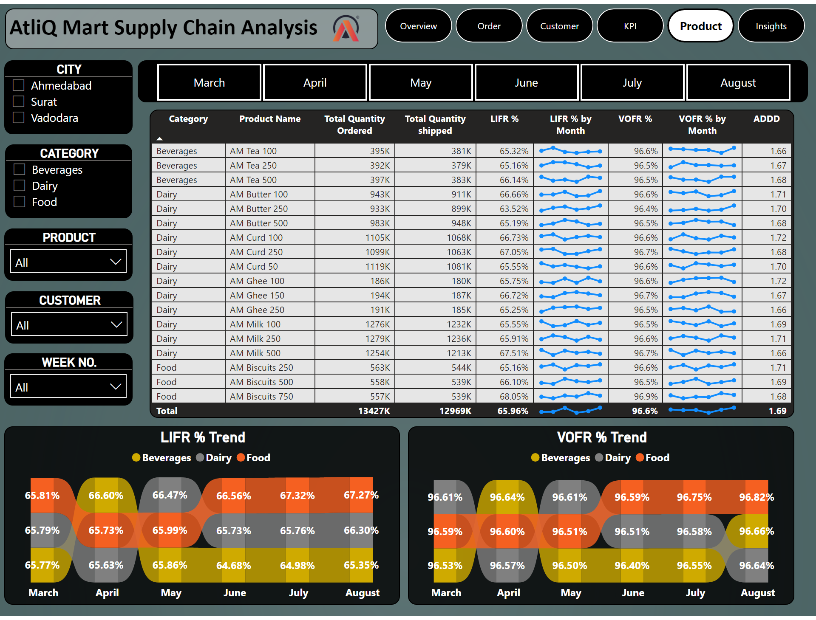
Product
Notes:
CITY
No alt text provided
Month
No alt text provided
CATEGORY
No alt text provided
PRODUCT
No alt text provided
CUSTOMER
No alt text provided
WEEK NO.
No alt text provided
image
No alt text provided
textbox
No alt text provided
tableEx
No alt text provided
LIFR % Trend
No alt text provided
VOFR % Trend
No alt text provided
pageNavigator
No alt text provided

Slide 18


Insights
AtliQ Marts product demand is almost equally distributed in all three cities, i.e., Vadodara, Surat and Ahmedabad.
There are 6 Customers name- Acclaimed Stores, Lotus Mart, Vijay Stores, Rel Fresh, Cool Blue & Propel Mart out of 15 customers, are constituting 53% of Total orders & seems to be key customers.
Diary products orders are 2 times more than the Food and Beverages orders Category.
All the Key Metrics (OT%, IF%, OTIF%) are far behind the target.
OT% is lagging by almost 31% each month, with being highest in March at 59.57%.
IF% is lagging by almost 30% each month, with being highest in July at 53.66%.
OTIF% lags by 53% each month, with the highest being in August at 29.39%.
There is no noticeable improvements in any of the key metrics in the last few months.

Slide 19
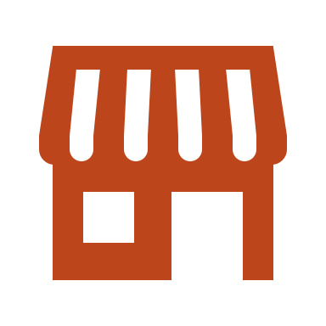
Insights
Ahmedabad City has the highest product orders with almost 11K orders, follows by Vadodara City with 10.97K Orders.
Based on orders delivery delayed, Vadodara city has the highest orders delayed with 42.02% of their total orders followed by Ahmedabad city with 41.84%.
Dairy products orders (37.74% of the total dairy products i.e. 9.50K ) are most delayed to deliver by 29.93% of the total orders.
40.97% of the total products i.e. 13K have been delivered late by 1, 2 or 3 days.
Approx. 13K orders had been delayed to deliver on an average of 1.69 days from the agreed delivery date.
For Acclaimed Stores , Cool Blue & Lotus Mart, more than 70% of their orders are being delivered late on an average of 1.82 days from the agreed delivery date.

Slide 20

Recommendations
Strengthen relationships with key customers: Acclaimed Stores, Lotus Mart, Vijay Stores, Rel Fresh, Cool Blue, and Propel Mart.
Allocate additional resources and attention to dairy products category due to consistently higher orders.
Develop strategies to improve key metrics (OT%, IF%, OTIF%) with a focus on consistency and performance analysis.
Establish a robust monitoring system for real-time tracking and proactive issue resolution.
Tailor city-specific strategies for Ahmedabad and Vadodara, the top cities in terms of orders.
Investigate reasons behind high order delays, especially in Vadodara and Ahmedabad, and implement corrective actions.
Optimize logistics and supply chain processes for dairy products to reduce delays.
Develop strategies to reduce overall late deliveries (40.97%) by refining schedules and improving warehouse efficiency.
Work closely with customers like Acclaimed Stores, Cool Blue, and Lotus Mart to understand and address specific challenges.
Foster a continuous improvement culture within the organization to refine processes and enhance overall performance.

